Slide 1
K- Means Clustering Algorithm Mohib Khan Data Scientist

Slide 2
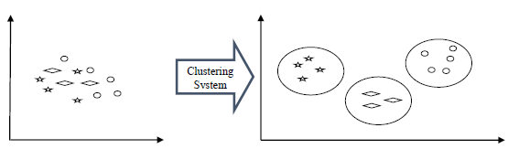
What is Cluster
Cluster: a collection of data objects
Similar to one another within the same cluster
Dissimilar to the objects in other clusters
Cluster analysis
Grouping a set of data objects into clusters

Slide 3
What is Cluster Analysis?
Clustering is unsupervised classification: no predefined classes
Typical applications
As a stand-alone tool to get insight into data distribution
As a preprocessing step for other algorithms

Slide 4
General Applications of Clustering
Pattern Recognition
Image Processing
Economic Science (especially market research)
WWW
Document classification
Cluster Weblog data to discover groups of similar access patterns

Slide 5
Examples of Clustering Applications
Marketing: Help marketers discover distinct groups in their customer bases, and then use this knowledge to develop targeted marketing programs
Land use: Identification of areas of similar land use in an earth observation database
Insurance: Identifying groups of motor insurance policy holders with a high average claim cost
City-planning: Identifying groups of houses according to their house type, value, and geographical location
Earth-quake studies: Observed earth quake epicenters should be clustered along continent faults

Slide 6
What Is Good Clustering?
A good clustering method will produce high quality clusters with
high intra-class similarity
low inter-class similarity
The quality of a clustering method is also measured by its ability to discover some or all of the hidden patterns.

Slide 7
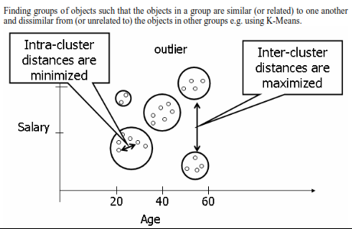
What Is Good Clustering?

Slide 8
K- Means Algorithm
This clustering algorithm computes the centroids and iterates until we it finds optimal centroid. It assumes that the number of clusters are already known. It is also called flat clustering algorithm. The number of clusters identified from data by algorithm is represented by ‘K’ in K-means.

Slide 9
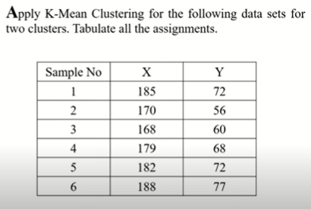
k-Means: Step-By-Step Example

Slide 10
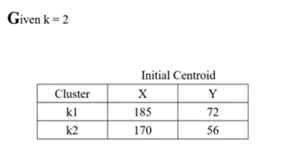
k-Means: Step-By-Step Example

Slide 11
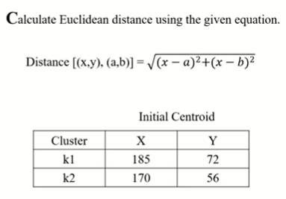
k-Means: Step-By-Step Example

Slide 12
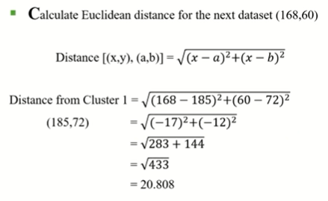
k-Means: Step-By-Step Example

Slide 13
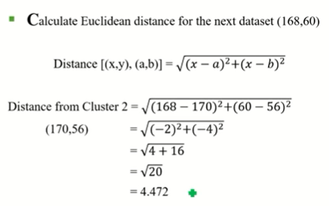
k-Means: Step-By-Step Example

Slide 14
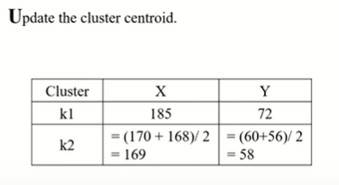
k-Means: Step-By-Step Example

Slide 15
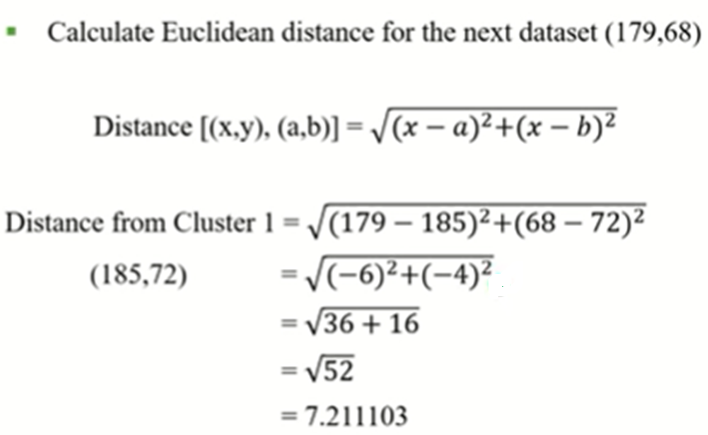
k-Means: Step-By-Step Example

Slide 16
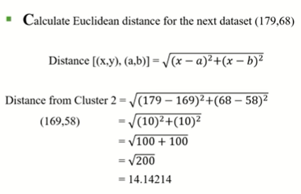
k-Means: Step-By-Step Example

Slide 17
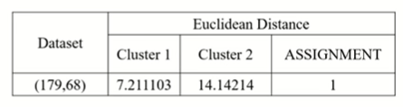
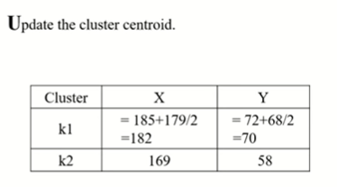
k-Means: Step-By-Step Example

Slide 18
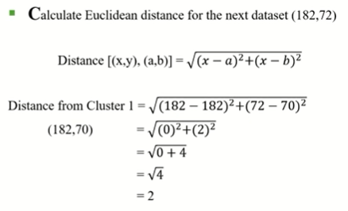
k-Means: Step-By-Step Example

Slide 19
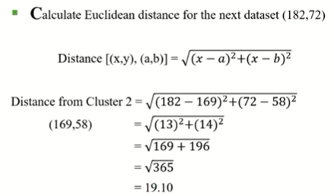
k-Means: Step-By-Step Example

Slide 20
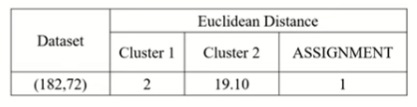
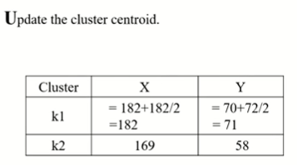
k-Means: Step-By-Step Example

Slide 21
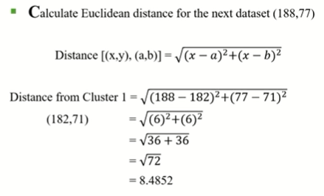
k-Means: Step-By-Step Example

Slide 22
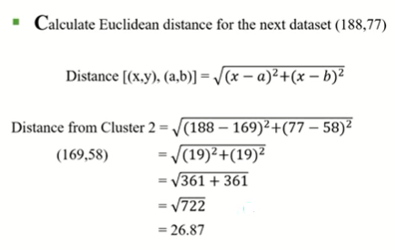
k-Means: Step-By-Step Example

Slide 23
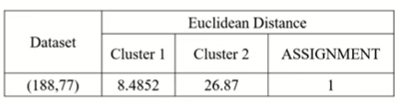
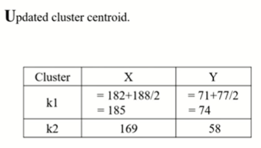
k-Means: Step-By-Step Example

Slide 24
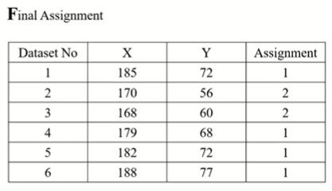
k-Means: Step-By-Step Example

Slide 25
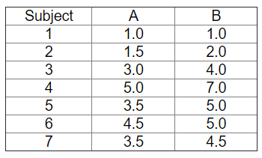
k-Means Example
Consider the following data set consisting of the scores of two subjects of seven students:

Slide 26
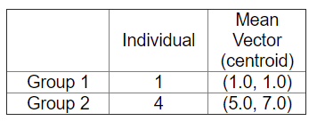
k-Means Example
This data set is to be grouped into two clusters. As a first step in finding a sensible initial partition, let the A & B values of the two individuals furthest apart (using the Euclidean distance measure), define the initial cluster means, giving:

Slide 27

k-Means Example
The remaining individuals are now examined in sequence and allocated to the cluster to which they are closest, in terms of Euclidean distance to the cluster mean. The formula for which is:

Slide 28
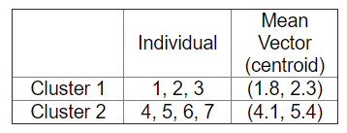
k-Means Example
Now the initial partition has changed, and the two clusters at this stage having the following characteristics:

Slide 29
Thank You

